Slide 1
E – LEARNING WEBSITE
WEB STACK DEVELOPMENT
Presented by:
Kavaskar S (2347230)
Likitha Yadav G (2347234)
Josanth Smilan A (2347228)
Evaluated By:
Dr. R Sridevi

Slide 2
Abstract
The "E-Learning Learning" project aims to create a dynamic and user-friendly online platform that will transform traditional education methods and make learning more accessible, engaging, and effective. In a rapidly evolving digital landscape, this project seeks to harness the power of technology to address the educational challenges of the 21st century.

Slide 3

Agenda
Introduction
Software Requirements
Hardware Requirements
Database
Screenshots
Conclusion

Slide 4

Introduction
The world has witnessed a seismic shift in how education is delivered, with e-learning emerging as a driving force. Our project is born out of the belief that education should not be confined to physical classrooms, rigid schedules, or geographical boundaries. We are dedicated to creating a platform that offers a wide range of courses, resources, and interactive experiences for learners worldwide.

Slide 5

Software Requirements
OS : Windows
IDE : VS code
Technical Requirements : Node js
Firebase

Slide 6

Hardware Requirements
RAM : 16GB
System : Laptop
Processor : Intel i5

Slide 7
Modules
Authentication Module
User Registration: Allowing users to create accounts by providing their email and password.
Dashboard Module
User Login: Allowing registered users to log in securely.
User Dashboard: A personalized dashboard for each user to track their courses, progress, and recent activity.
Course Catalog: A section where users can browse and search for available courses.

Slide 8
Edit/Delete Courses: Allowing instructors to manage their courses.
Course Content: Displaying course materials, videos, documents, and interactive lessons.
Course Management Module
Progress Tracking: Recording and displaying the user's progress within a course.
Grading System: Automatically or manually grading assignments and quizzes.
Interactive Learning Module
Admin Panel: An admin dashboard to manage users, courses, and system settings.
User Roles: Assigning roles such as students, instructors, and administrators.
User Management

Slide 9

Database : Firebase is a comprehensive and versatile mobile and web application development platform offered by Google. It equips developers with a powerful set of tools and services to build, manage, and scale applications more efficiently. Whether you're creating a simple mobile app, a complex web application, or even a game, Firebase provides a unified solution for a variety of tasks, from backend infrastructure to user engagement and analytics.

Slide 10
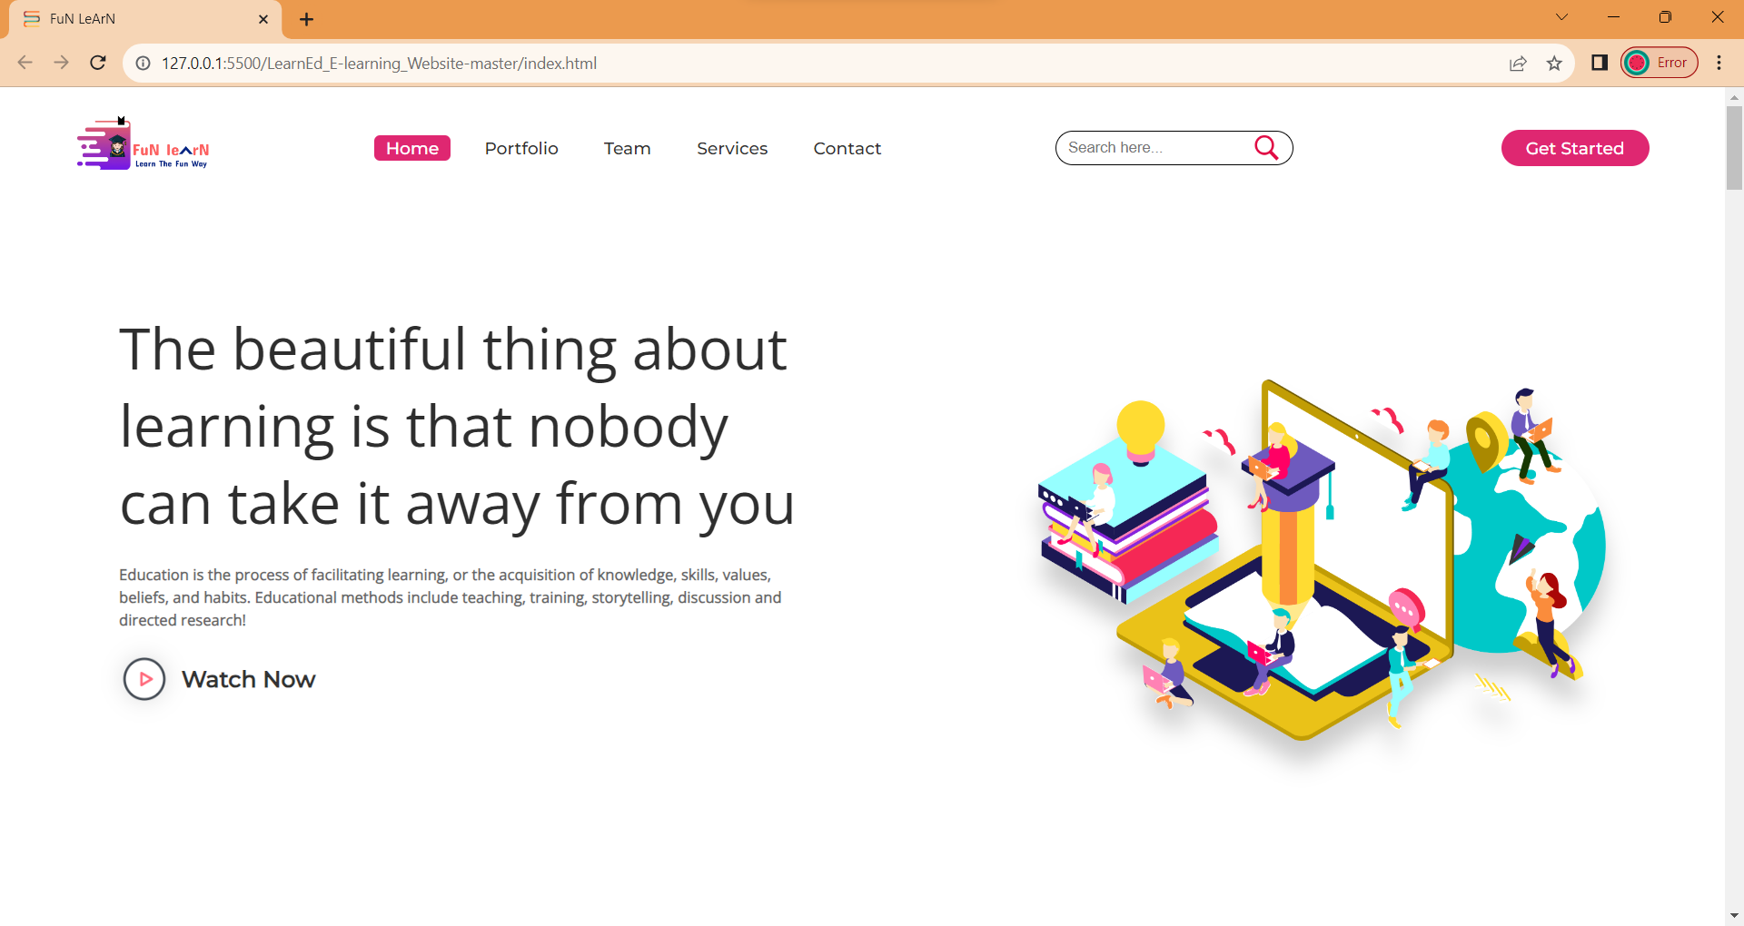
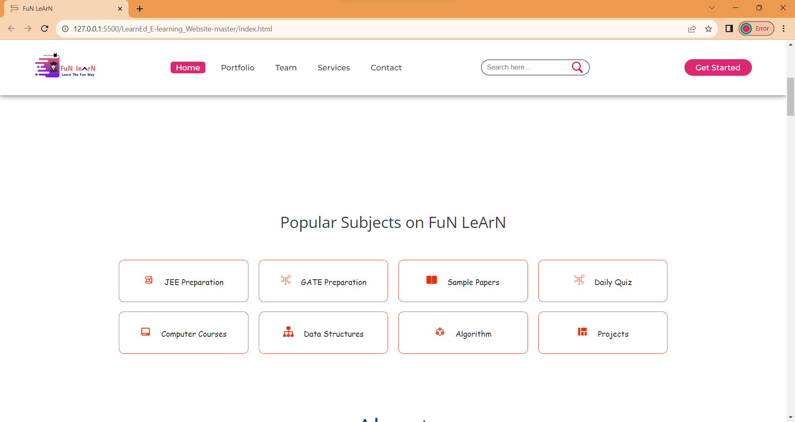
Screenshots :

Slide 11
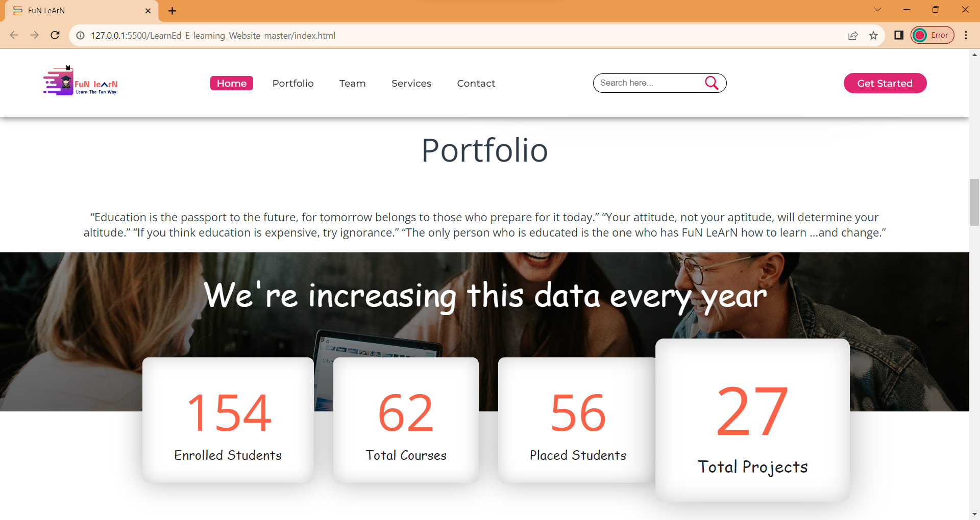
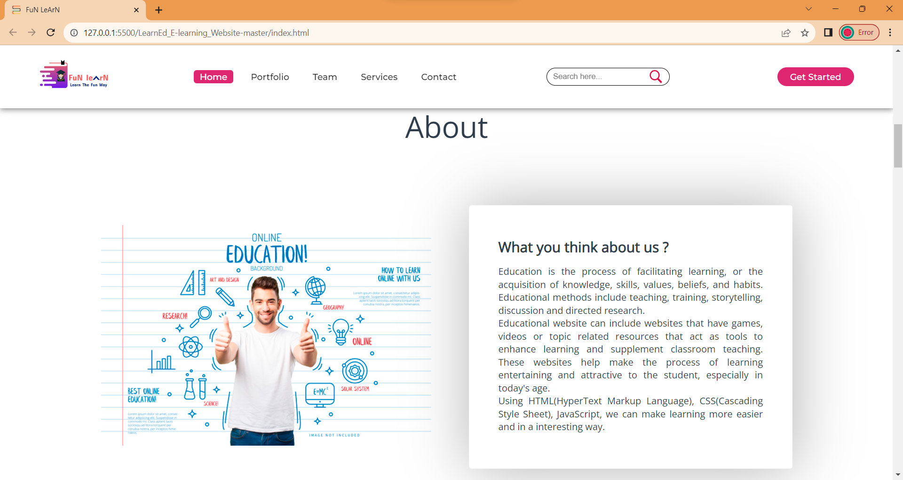

Slide 12
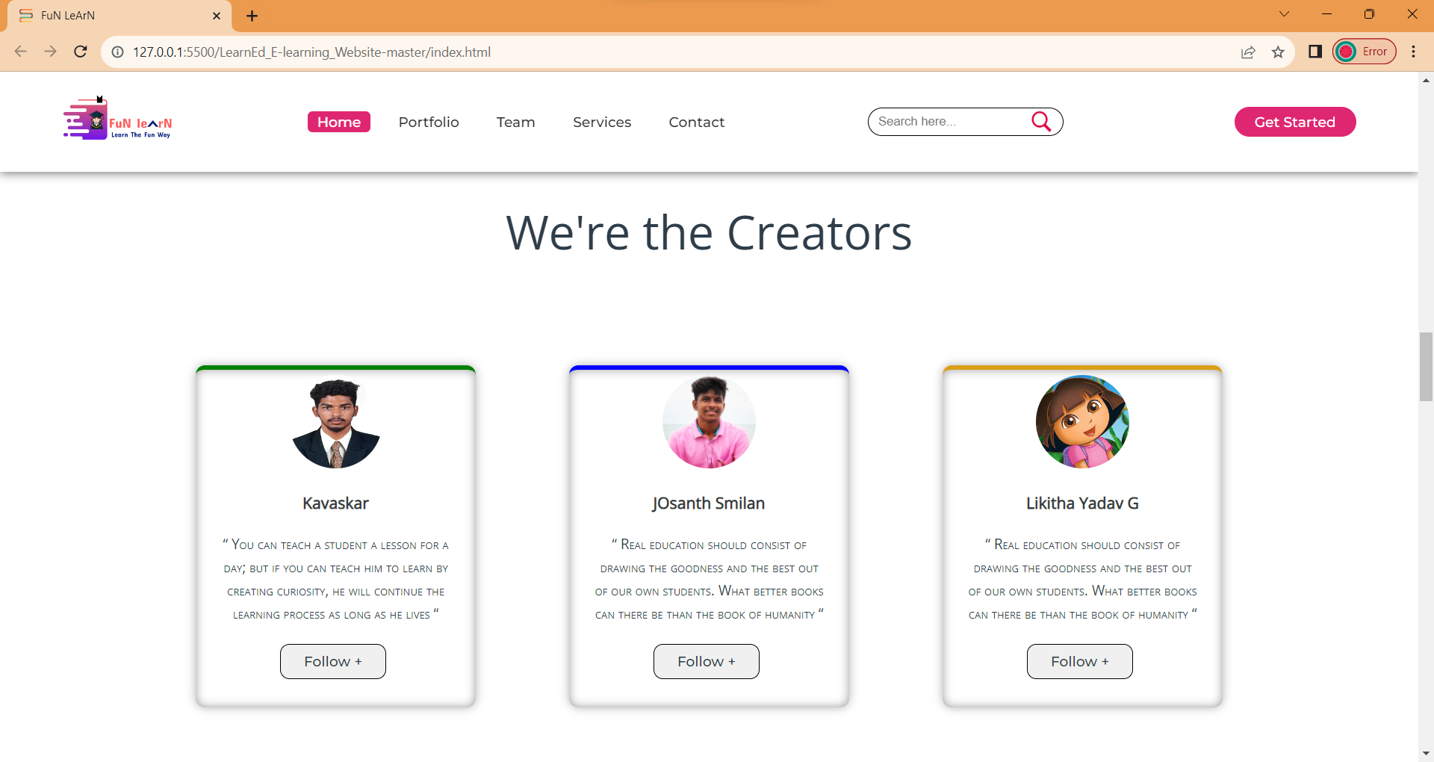
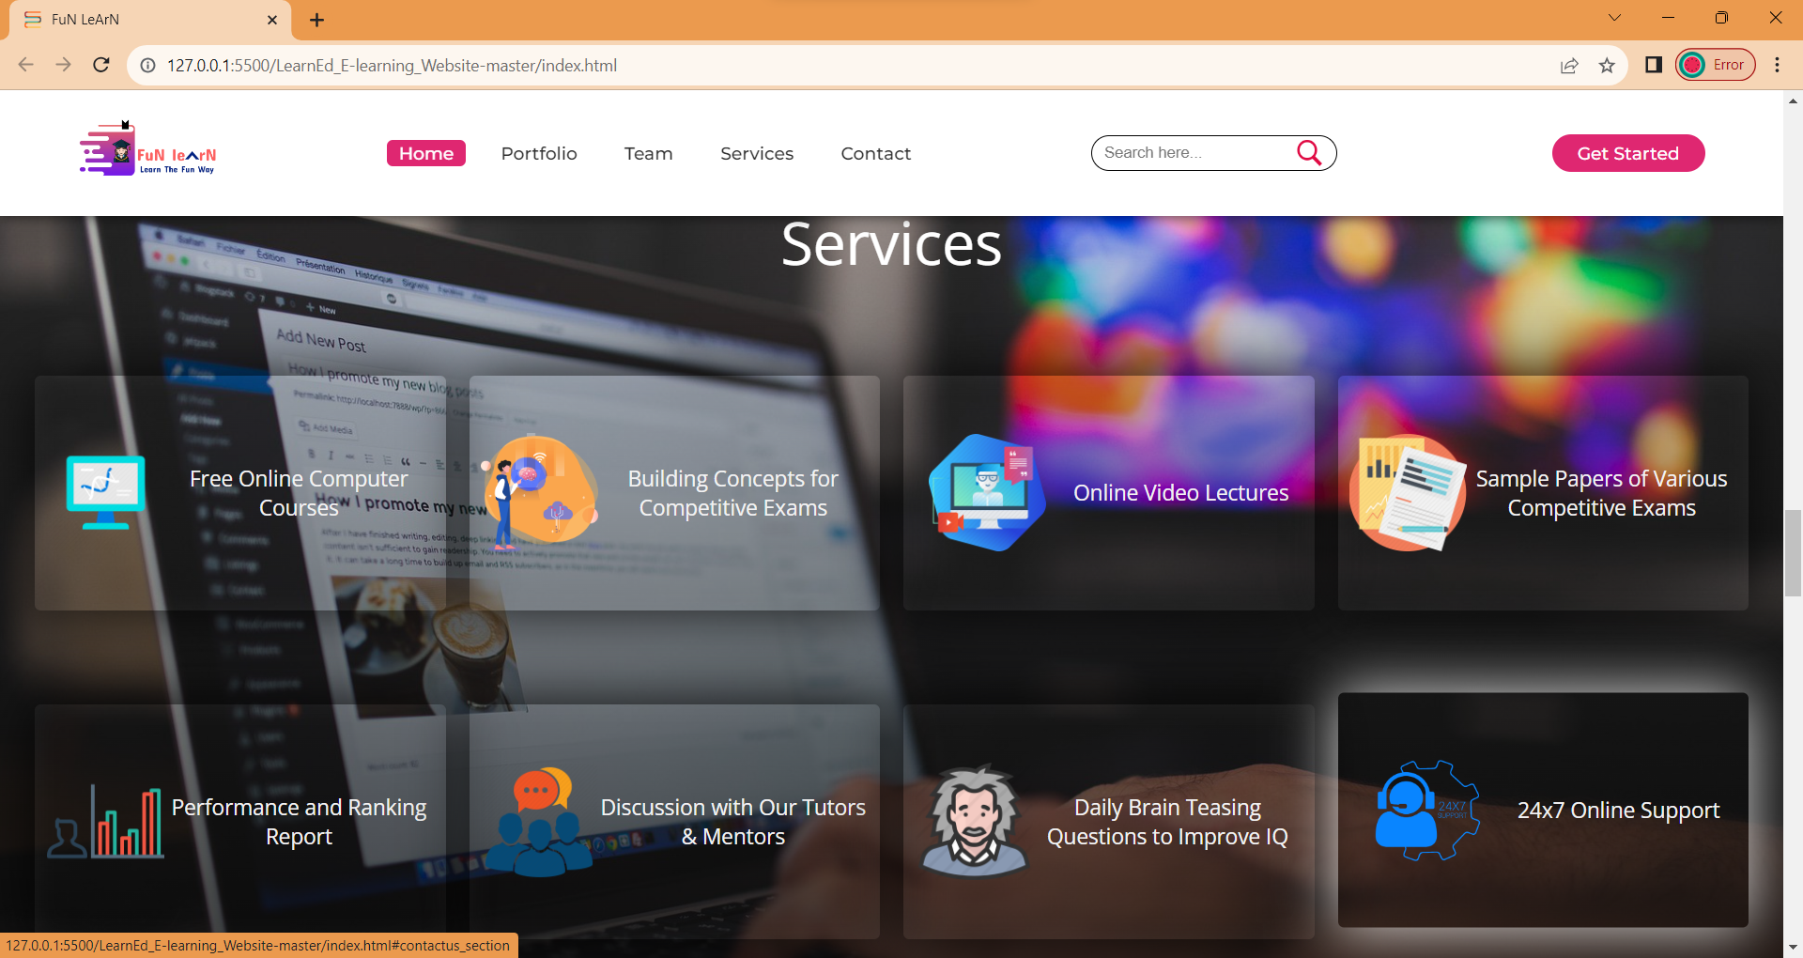

Slide 13
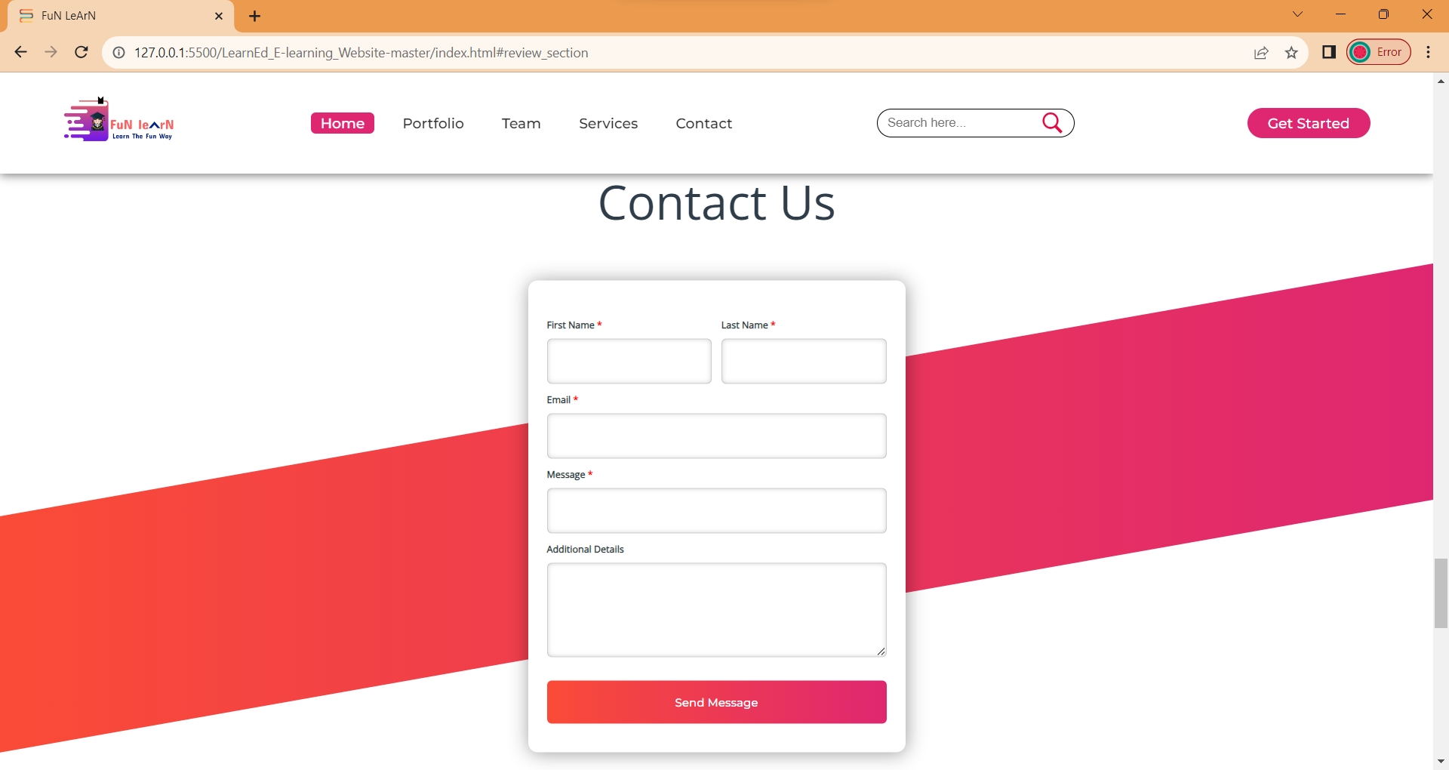
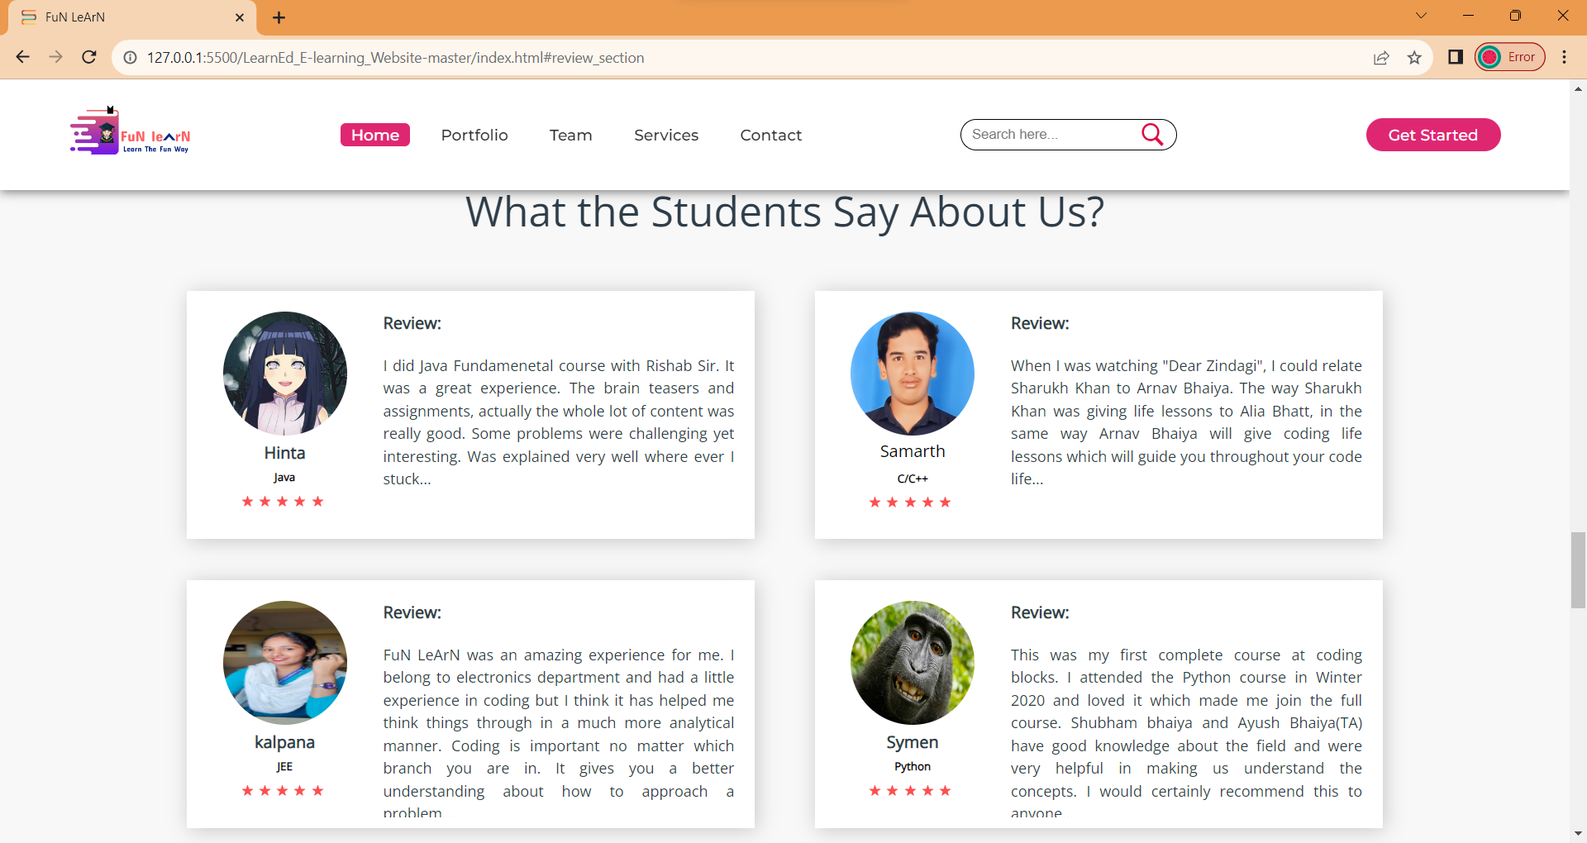

Slide 14
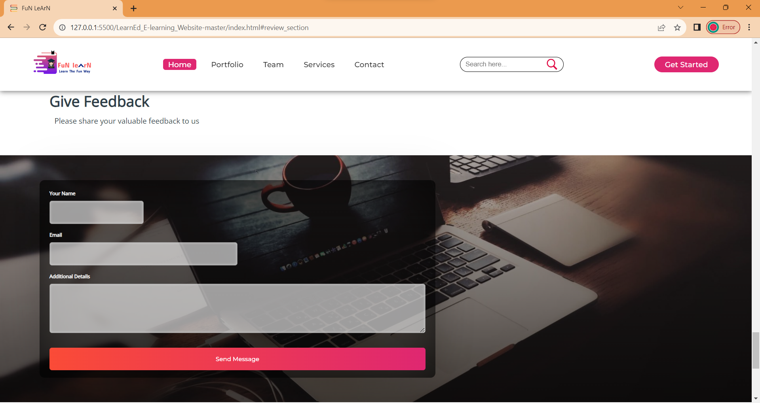
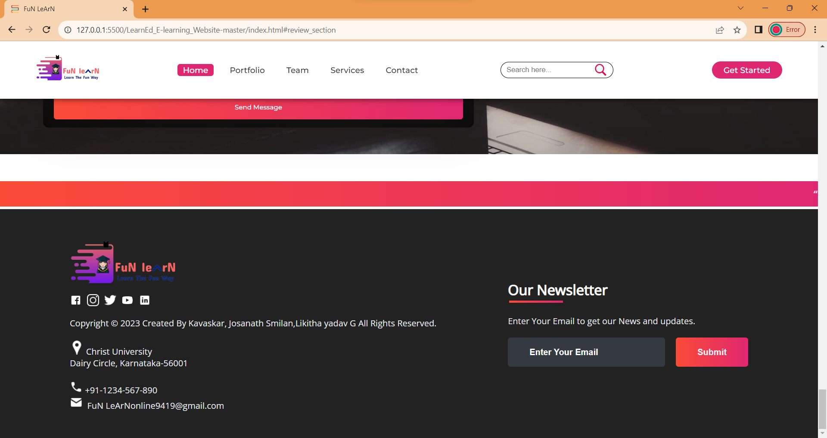

Slide 15
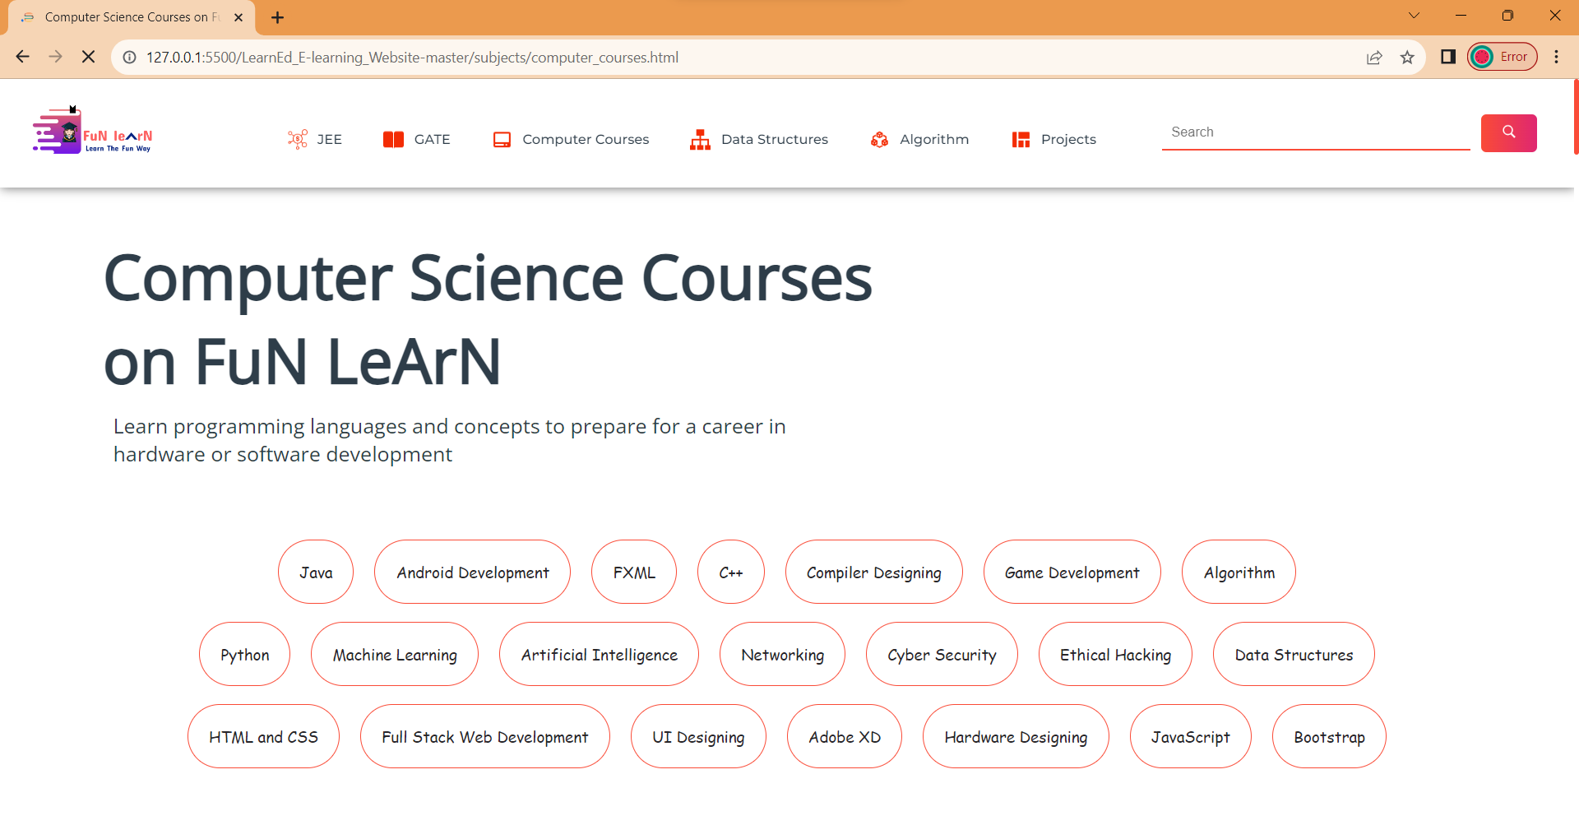
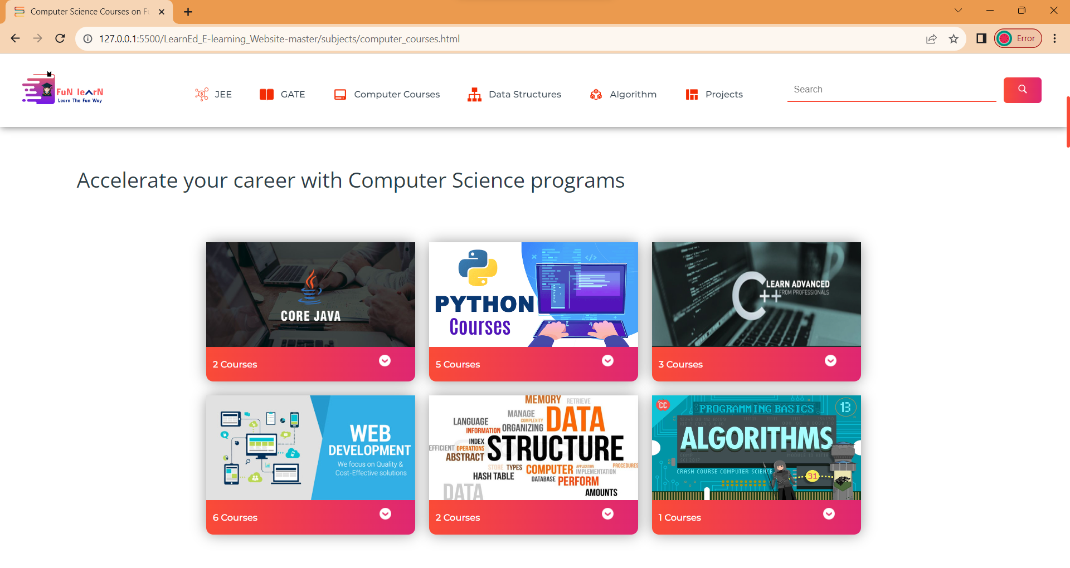

Slide 16
Conclusion :
the advent of e-learning websites has revolutionized education by providing accessible, flexible, and interactive learning opportunities to a global audience. These platforms have not only bridged geographical barriers but have also adapted to diverse learning styles and preferences. With a wealth of educational resources, ranging from video lectures and quizzes to discussion forums and live webinars, e-learning websites offer learners the autonomy to tailor their educational journey.

Slide 17
Thanks!

